Slide 1

Healthy Families New York
Child Abuse and Maltreatment Policy

Slide 2
Objectives
To have a better understanding of:
The GA-4A Policy and requirements to make a report to the New York State Central Register.
Who is a Mandated Reporter?
The Supervisors Role in supporting staff
Family notification and engagement
An overview of child abuse and neglect definitions
Decision Tree for reporting suspicion of child abuse and neglect
Tracking and Follow Up

Slide 3

What this is not
This is not a mandated reporter training and it does not meet the criteria required for mandated reporters. If you need mandated reporter training, please go to www.nysmandatedreporter.org
Please note, you are not a mandated reporter just because you use or take the above training.

Slide 4





Policy Intent
  A clear understanding of child abuse neglect indicators and the states definitions of child abuse and neglect will assist staff in knowing how and when to report.
  It is the intent that site leadership is notified in advance of a call to the SCR, HOWEVER Staff clearly understand that contacting the police or SCR prior to immediate notification of the site manager or supervisor is appropriate ONLY when waiting to contact the authorities may cause risk or harm the child(ren) or themselves.
It is important for staff to know who to contact for support when abuse and neglect is suspected
All staff including supervisors, should adapt a mandated reporter philosophy, even if NYS does not identify them as
mandated reporters
  It is important for all staff to familiarize themselves with the mandated reporter laws, which places ultimate responsibility on staff to report suspicion of abuse or neglect to the SCR without risk or jeopardy, even in situations where site leadership does not agree with the need to report.

Slide 5
HFA BPS GA-4A
Home visitors are not considered mandated reporters under section 413 of New York State Social Service Law. However, in order to meet the HFA Best Practice Standards, and HFNY Policy, home visitors, supervisors, and program managers are required to make a call to the SCR when they suspect child abuse or maltreatment.

Slide 6
HFNY Home Visitor’s Role in the Reporting of Child Abuse or Neglect
Home visitors are not mandated reporters under NY State law, are not legally required to make a report when they suspect child abuse or neglect, and cannot be charged with a crime if they do not report an incidence of suspected child abuse and neglect. There could be disciplinary action taken by your agency.
However, HFA's Best Practice Standards and HFNY Policy require home visitors, supervisors and program managers to make a report to the State Central Registry (SCR) when they suspect child abuse or maltreatment, EVEN IN situations where they believe a report has already been made by another individual or organization.
When a home visitor suspects child abuse or neglect, they are to communicate this to their supervisor immediately or as soon as possible. If the home visitor and supervisor agree that there is a “reasonable cause to suspect” child abuse or neglect, the home visitor will promptly call the SCR with the support of the supervisor. The SCR will then determine whether the circumstances warrant filing a report to initiate further investigation.
Other Considerations:
  If the home visitor believes that a child is in immediate danger, they should call 911 first, then inform their supervisor as soon as possible.
  If the supervisor believes the situation does not warrant calling the SCR but the home visitor does, the home visitor can call the SCR without penalty and with supervisory support, if needed.

Slide 7
Reasonable Cause to Suspect:
Reasonable cause to suspect child abuse or maltreatment means that, based on your rational observations, professional training or experience, you have suspicion that a parent or guardian or other person legally responsible for a child is responsible for harming that child or placing that child in imminent danger of harm. Your suspicion can be as simple as distrusting an explanation for an injury. Other person legally responsible refers to a guardian, caretaker, or other person over 18 years of age who is responsible for the care of the child.

Slide 8
Mandated Reporter Philosophy:
Staff act as mandated reporters except they speak with their supervisor prior to making a report. Then staff make reports to the SCR when they have reasonable cause to suspect that a child is an abused or maltreated child, OR when they have reasonable cause to suspect that a child is an abused or maltreated child when the parent or other person legally responsible tells staff personal knowledge, facts, conditions or circumstances. Staff may make the report to the SCR with the support of the supervisor.

Slide 9
Definition of Abuse and Maltreatment
A call to the SCR must be made if a staff member suspects that a child has experienced one of the following types of Abuse or Maltreatment (includes neglect) including but not limited to failure to exercise a minimum degree of care or sexual/physical abuse against the child or allowing sexual or physical abuse to be committed.
What is Abuse?
Abuse encompasses the most serious injuries and or risk of serious injuries to children by their caregivers. An abused child is one whose parent or other person legally responsible for his or her care inflicts serious physical injury upon the child, creates a substantial risk of serious physical injury, or commits a sex offense against a child. Abuse also includes situations where a parent or other person legally responsible knowingly allows someone else to inflict such harm on a child.
What is Maltreatment?
When a child’s physical, mental or emotional condition has been impaired, or placed in imminent danger of impairment, by failure of the child’s parent or other person legally responsible to exercise a minimum degree of care by:
  Failing to provide sufficient food, clothing, shelter, education or;
  Failing to provide proper supervision, guardianship, or medical care (refers to all medical issues including dental, optometric, or surgical care) or;
  Inflicting excessive corporal punishment, abandoning the child, or misusing alcohol or other drugs to the extent that the child was placed in imminent danger.

Slide 10
What to do in the event of suspected abuse or neglect
According to HFA BPS GA-4A, if staff suspects child abuse or neglect, they should immediately speak with their supervisor or site leadership and make a report to the SCR. If imminent danger is threatened, the home visitor is to call 911 prior to calling the supervisor or the SCR.
Workers should speak with the supervisor first:
Staff should understand that contacting the police or the SCR prior to immediate notification of the site manager or supervisor is appropriate ONLY IF waiting to contact the authorities may cause greater risk to the child(ren). It is essential that there is always a supervisor or site leadership available for staff to speak to.
What to do if the SCR does not take the report and you are still concerned:
Ask to speak with a supervisor while you are on the phone with the SCR operator.
Wait a few minutes and call back. A different representative may hear the information differently.
If you are still concerned, call your OCFS Program Contract Manager.

Slide 11
Supervisory Support
According to HFA BPS GA-4A, Supervisors should provide support and guidance regarding the staff member’s observations and concerns. The supervisor should not attempt to dissuade the FSS or FRS from making a call to SCR. It should be noted that proof of abuse or maltreatment is not necessary to call the SCR. If program staff are unsure whether a report should be made, the SCR should be called. The SCR staff will make the determination as to whether a report should be registered. In the event of a call being made to the SCR, it is the supervisor’s role to help the FSS or FRS gather the necessary information to make the call to SCR and help advise the worker on how to continue working with the family.
Considerations for Supervisors:
Workers may be upset about having to report a family that they have a relationship with.
Workers may be unsure whether a report should be made. When program management is unsure, make the call to the SCR and the SCR staff will determine whether to register a report.

Slide 12
FSS, FRS, & Supervisor Considerations
All you need in order to call is a suspicion that the parent or other person legally responsible for the child is responsible for harming or neglecting the child or placing that child in danger of harm. Your suspicion can be as simple as distrusting an explanation for an injury.
If you have suspicion and you believe another individual or organization has called, you are still required to make the report. The other individual or organization might not have called OR you may have additional information that the other individual or organization does not.
You do not need evidence to make a report. You are not trained to gather evidence. Please do not try to evaluate injuries, interview witnesses, or further evaluate the situation.
Program capacity is never more important than the safety of a child. The family may need additional interventions that Healthy Families cannot provide. In some instances, a report can and has actually improved the relationship with the family.
While the FSS/FRS roles are not legally mandated reporters, ethically there is a responsibility to make a call if there is suspected abuse or neglect. The SCR will make the final determination. You may be the only voice this child has.

Slide 13
Family Engagement around reporting to the SCR
According to HFA BPS GA-3A, families are informed of the limits of confidentiality at intake, including the requirement to report to the SCR if needed.
Be honest about the requirement to report at the first encounter with the family and at enrollment.
Talk about how the program can support the family once a report is made.
Talk about how to maintain a relationship with the family if a report is made.
Ask the family how they would want to handle the situation- would they prefer to make the report themselves?
Let the family know if there’s something you see that could turn into a reportable situation (anticipatory guidance).

Slide 14
Family Relationships
An important use of the home visitor’s relationship with the family may be informing the family that it was the program that made the call to SCR; it removes the additional stress on the family of not knowing who made the report, and models respectful trust-building relationships.
That said, when circumstances make informing the family, either prior to or after calling the SCR, unsafe for family members or staff, it is up to the supervisor and home visitor to determine how to handle the incident and move forward to preserve the relationship with the family.

Slide 15
Orientation and Ongoing Training
According to HFA BPS GA-4A, all Program Managers, FRS and FSS supervisors, FSS and FRS positions, interns and volunteers receive orientation prior to direct services with families or supervision of staff. This orientation, BPS 10-2.D, must ensure that staff clearly understand how to identify child abuse and neglect, and are aware of the legal limits of confidentiality. Additionally, as per BPS 11-4.B, all staff receive annual training related to child abuse and neglect in order to stay updated on current child welfare policies, practices, and trends in their community.

Slide 16
Indicators of Maltreatment
(1) Indicators of maltreatment can include but are not limited to:
a. Failing to provide the child with food, clothing, shelter, education, medical or
surgical care, though financially able to do so or offered financial or other
reasonable means to do so.
b. Failing to Provide a child with proper supervision or guardianship.
c. Unreasonably inflicting, or allowing to be inflicted, harm or substantial risk
thereof, including but limited to the infliction of excessive corporal
punishment.
d. The misuse of drugs or alcohol to the extent of loss of control.
e. By abandoning the child.

Slide 17
Indicators of Sexual Abuse
(2) Indicators of sexual abuse can include but are not limited to:
a. Injury to genital area.
b. Symptoms of sexually transmitted diseases.
c. Sexually suggestive, inappropriate, or promiscuous behavior or verbalization.
d. Expressing age in-appropriate knowledge of sexual relations.
e. Sexual victimization of other children.

Slide 18
Indicators of Physical Abuse
(3) Indicators of physical abuse can include but are not limited to:
a. Injuries to the eyes or both sides of the head or body.
b. Frequent injuries of any kind. These may appear in distinctive patterns such as grab mark, human bite marks, cigarette burns, or impressions with other instruments.
c. Destructive, aggressive, or disruptive behaviors.
d. Passive, withdrawn, or emotionless behavior.
e. Fear of going home.

Slide 19
Positions/Titles that ARE Mandated Reporters (SSL 413)
The following persons and officials are required to report or cause a report to be made in accordance with this title when they have reasonable cause to suspect that a child coming before them in their professional or official capacity is an abused or maltreated child where the parent, guardian, custodian, or other person legally responsible for such child comes before them in their professional or official capacity and stated from personal knowledge facts, conditions or circumstances which, if correct would render the child an abused or maltreated child:
Medical Professionals:
Physician
Registered physician assistant
Surgeon
Medical examiner
Coroner
Dentist
Dental hygienist
Osteopath
Optometrist
Chiropractor
Podiatrist
Resident
Registered nurse
Medical intern
Emergency medical technician
Hospital personnel engaged in the admission, examination, care, or treatment of persons
Social Services Professionals:
Social worker
Social services worker
Employee of a publicly-funded emergency shelter for families with children
Employee or volunteer in a residential care facility for children that is licensed, certified or operated by OCFS, or any other child care or foster care worker
Substance abuse counselor
Alcoholism counselor
All persons credentialed by Office of Alcoholism and Substance Abuse Services (OASAS)
Employees who are expected to have regular and substantial contact with children of a health home, or health home care management agency contracting with a health home, as designated by the DOH and authorized under section 365-1 of this chapter or such employees who provide home and community based services under a demonstration program pursuant to section 1015 of the federal social security act who are expected to have regular and substantial contact with children
Mental Health Professionals:
Psychologist
Licensed creative arts therapist
Licensed marriage and family therapist
Licensed mental health counselor
Licensed psychoanalyst
Licensed behavioral analysist
Certified behavioral analysist
Other Mental health professional

Slide 20
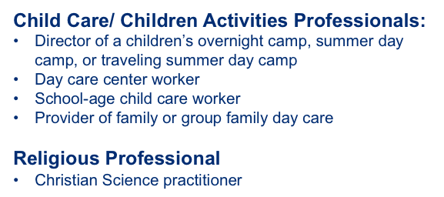
Positions/Titles that ARE Mandated Reporters (SSL 413)
(Cont’d)
Education Professionals - school officials, which includes but is not limited to:
School teacher
School guidance counselor
School psychologist
School social worker
School nurse
School administrator or other school personnel required to hold a teaching or administrative license or certificate, full or part-time compensated school employee required to hold a temporary coaching license or professional coaching certificate
Law Enforcement Professionals:
Peace officer
Police officer
District attorney
Assistant district attorney
Investigator employed in the office of a district attorney
Other law enforcement official

Slide 21

What happens if…
I have a title on the list?
  You must follow the Mandated Reporter Law. As soon as you suspect abuse or maltreatment, you must report your concerns by telephone to the SCR.
  I DO NOT have a title on the list?
  If you or the child is in immediate danger, call 911. Otherwise, follow the flow chart to make your decision.

Slide 22
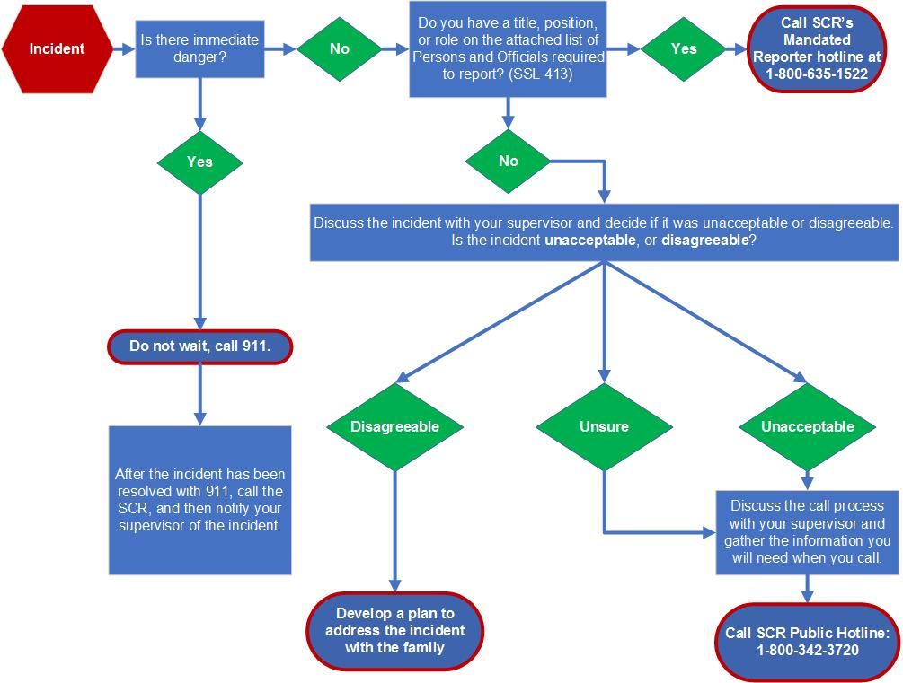
Decision
Tree For Reporting to the SCR

Slide 23


Tracking and Follow Up
According to BPS GA-4A and HFNY Policy, when a staff member makes a report to the SCR, the program is required to track the report was made and follow up on all children with suspected cases of abuse or neglect.
When staff make a report to the SCR, supervisors must track the call by clicking the box “CPS/ACS” and follow the prompts in the supervision form in MIS.
The Supervisor and FSS should work together to add the risks that led to the call on the HFNY Service Plan to provide support to families to mitigate the risks.

Slide 24

Our concern is the safety of our children. –Keith Sullivan
Photo by MI PHAM on Unsplash

